Slide 1

CLOUD COMPUTING Project Presentation
Topic - “ Car Selling Price Prediction”
Submitted By :-
Manish Gautam(181500366)
Nikhil Baghel (181500424)
Shreshtha Tola (181500688)
Department of Computer Engineering and Applications
Institute of Engineering and Technology
GLA University
Mathura-281406, India

Slide 2

PROBLEM STATEMENT
The Car Selling Price prediction is a Machine Learning Model used to predict the selling price of any car with high accuracy rate and least error (MSE) and validates the output using various train and test features such as:
• Car’s release date,
• No of previous owners that used the car,
• The latest showroom price,
• Distance travelled by the car until now(kilometers)
• Input Fuel Type (Petrol/Diesel/Gas)
• Transmission Type (Automatic/Manual)

Slide 3

What is the Idea ?
By implementing various Machine Learning algorithms to Train and test the model, some of the libraries used are numpy, sklearn, pandas, jsonify, scipy, etc. and algorithms used are onehot encoding, Regression, Classification and NPL and more.
After the model is well trained and tested it is further deployed of cloud using the various Cloud Platforms such as Heroku Cloud, AWS Cloud, Microsoft Azure Cloud or Google Cloud.

Slide 4

Motivation Behind.…
The objective/motivation behind this project was to create and deploying a cloud project which may give a good and accurate car selling price prediction using various ML algorithms and to display out with the least error(known as Mean Squared Error) in prediction rate. From the past learning and implementation in AI ML models to predict output based on various features given or provided in the model to train and test we implemented this Project.

Slide 5
ABSTRACT
Car Selling price prediction, as described above, can lead to error free, secure, reliable and fast management system. It can assist the user to concentrate on their other activities rather to concentrate on the record keeping. Thus it will help organization in better utilization of resources. The organization can maintain computerized records without redundant entries. That means that one need not be distracted by information that is not relevant, while being able to reach the information.

Slide 6

Technologies Used
For the completion of the task the following Web-languages and scripts have been used:
HTML
CSS
Cloud Computing
Machine Learning
Git and Github
Heroku cloud platform

Slide 7
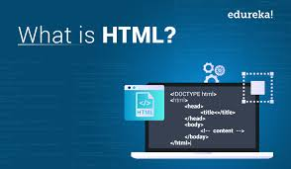
HTML
HTML stands for Hypertext Markup Language, and
it is the most widely used language to write Web Pages.
Hypertext refers to the way in which HTML documents are linked together.
Thus, the link available on a webpage is called Hypertext.
As its name suggests, HTML is a Markup Language which means you use HTML to simply "mark-up" a text document with tags that tell a Web browser how to structure it to display.
HTML is being widely used to format web pages with the help of different tags available in HTML language.
HTML is the language for publishing web pages on the WWW (World-Wide Web).
HTML is a Document Description Language (aka Document Markup Language).
HTML is NOT a programming language like C/C++/C#/Java, which is used to implement programming algorithm.
You need a web browser to view the HTML pages. The web browsers do not display the HTML tags, but uses the tags to interpret the content of the web pages.
An HTML document is a text document, and it is human-readable

Slide 8
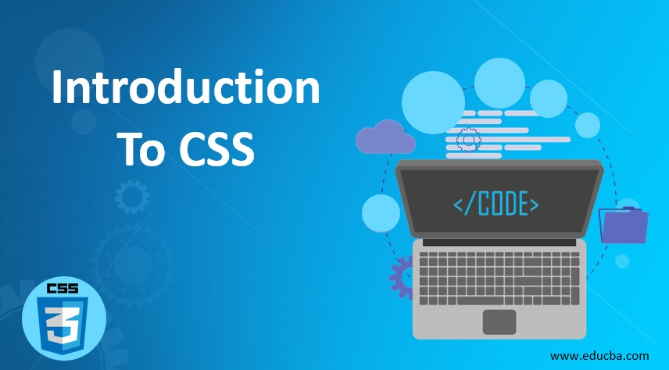
CSS
CSS is acronym for Cascading Style Sheets and is a markup language
responsible for how your web pages will look like.
It controls the colors, fonts, and layouts of your website elements.
It is a style sheet language used for describing the presentation of a document written in a markup language like HTML. CSS is designed to enable the separation of presentation and content, including layout, colors, and fonts.
CSS has a simple syntax and uses a number of English keywords to specify the names of various style properties.
A CSS comprises of style rules that are interpreted by the browser and then applied to the corresponding elements in your document.
Each rule or rule-set consists of one or more selectors, and a declaration block.
A style rule is made of three parts :−
Selector − A selector is an HTML tag at which a style will be applied. This could be any tag like <h1> or <table> etc.
Property − A property is a type of attribute of HTML tag. Put simply, all the HTML attributes are converted into CSS properties. They could be color, border etc.
Value − Values are assigned to properties. For example, color property can have value either red or #F1F1F1 etc.

Slide 9

CLOUD COMPUTING
cloud computing is the delivery of computing services—including servers, storage, databases, networking, software, analytics, and intelligence—over the Internet (“the cloud”) to offer faster innovation, flexible resources, and economies of scale. You typically pay only for cloud services you use, helping lower your operating costs, run your infrastructure more efficiently and scale as your business needs change.
Most cloud computing services fall into four broad categories: infrastructure as a service (IaaS), platform as a service (PaaS), serverless and software as a service (SaaS). These are sometimes called the cloud computing stack because they build on top of one another.

Slide 10

Machine Learning
Machine learning is a method of data analysis that automates analytical model building. It is a branch of artificial intelligence based on the idea that systems can learn from data, identify patterns and make decisions with minimal human intervention.
Machine Learning is the field of study that gives computers the capability to learn without being explicitly programmed. ML is one of the most exciting technologies that one would have ever come across. As it is evident from the name, it gives the computer that makes it more similar to humans: The ability to learn. Machine learning is actively being used today, perhaps in many more places than one would expect.

Slide 11

Git & Github
Git is a free and open source distributed version control system designed to handle everything from small to very large projects with speed and efficiency.
Git is easy to learn and has a tiny footprint with lightning fast performance. It outclasses SCM tools like Subversion, CVS, Perforce, and Clear Case with features like cheap local branching, convenient staging areas and multiple workflows.
GitHub is a Git repository hosting service, but it adds many of its own features. While Git is a command line tool, GitHub provides a Web-based graphical interface. It also provides access control and several collaboration features, such as a wikis and basic task management tools for every project.

Slide 12

Heroku CLOUD PLATFORM
Heroku is a container-based cloud Platform as a Service (PaaS). Developers use Heroku to deploy, manage, and scale modern apps. Our platform is elegant, flexible, and easy to use, offering developers the simplest path to getting their apps to market.
Heroku is a platform as a service (PaaS) that enables developers to build, run, and operate applications entirely in the cloud.

Slide 13

Implementation And User Interface (UI):

Slide 14
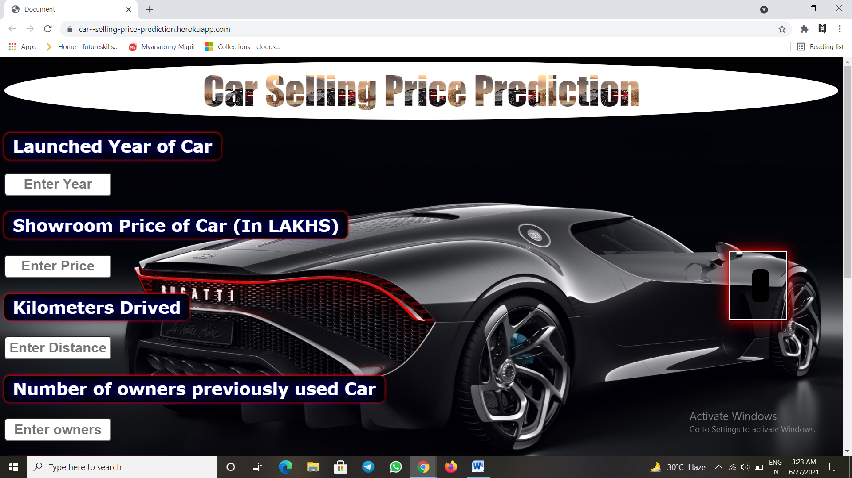
This form to submit details that appear after the Training of model

Slide 15
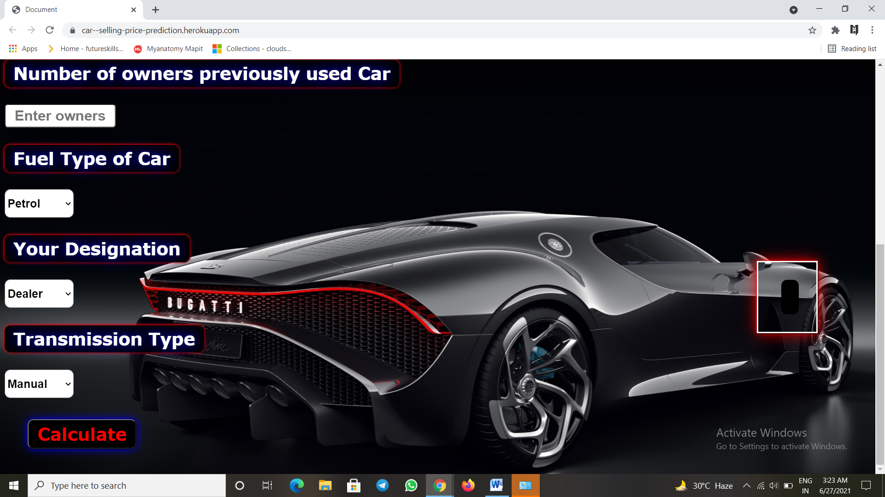
This is the form submit button

Slide 16

The entries for
Launched Year of car
Showroom price of the car (in lakhs)
distance travelled
number of previous owners

Slide 17
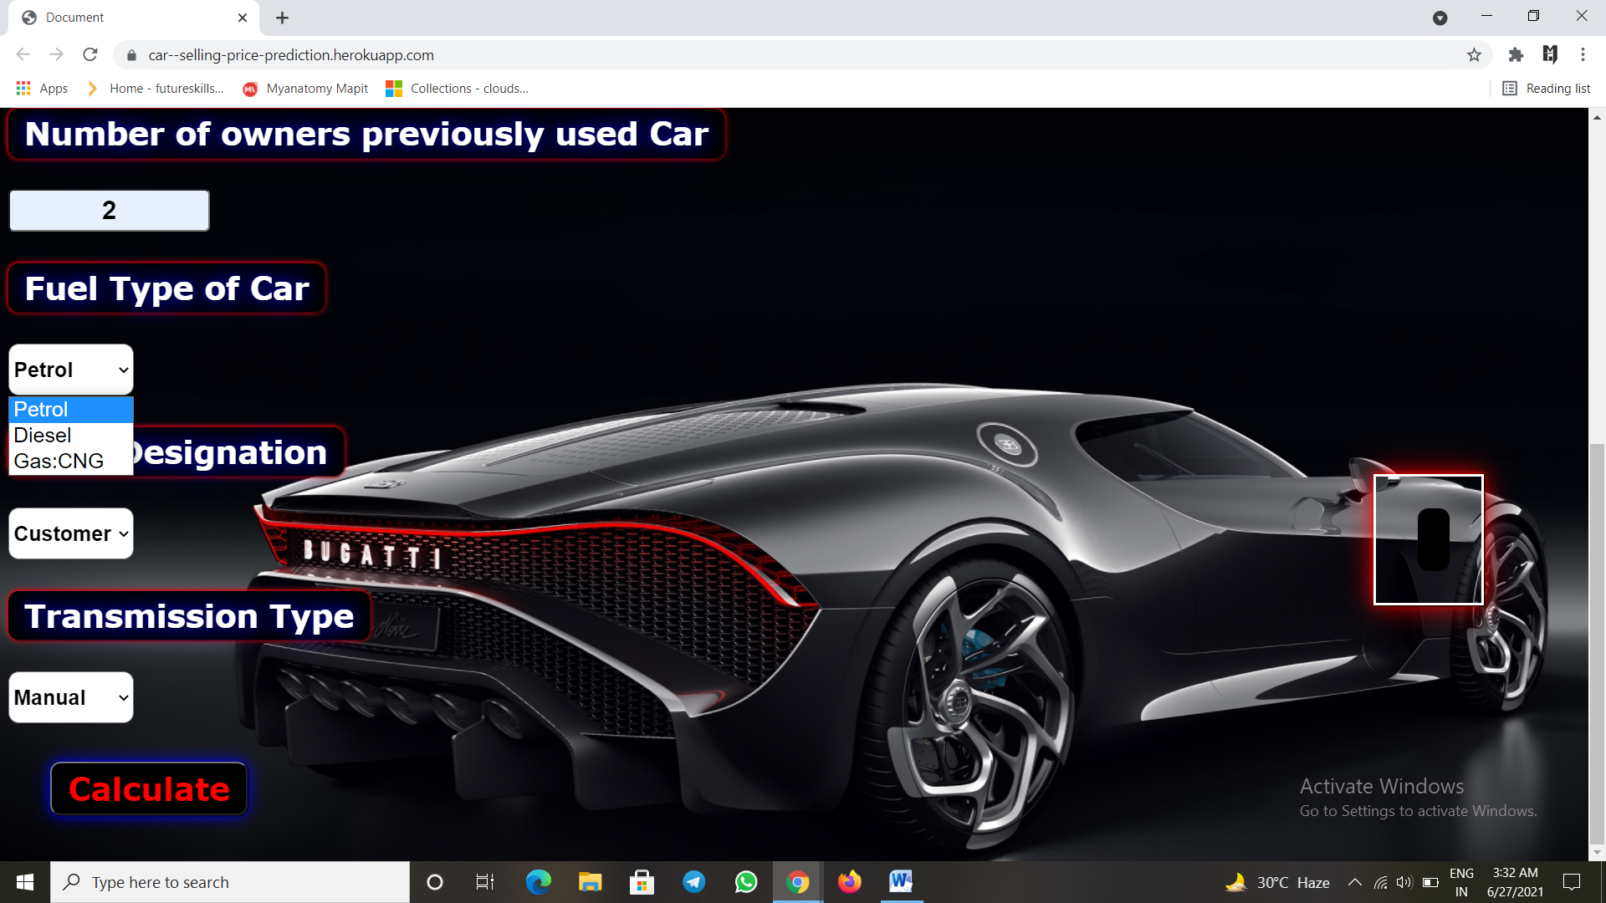
These input boxes have multi option entries for:
a. Fuel type of the car (petrol/diesel/CNG)
b. Our Desgnigation (Customer/Dealer)
c. Transmission type (manula/Automatic)

Slide 18
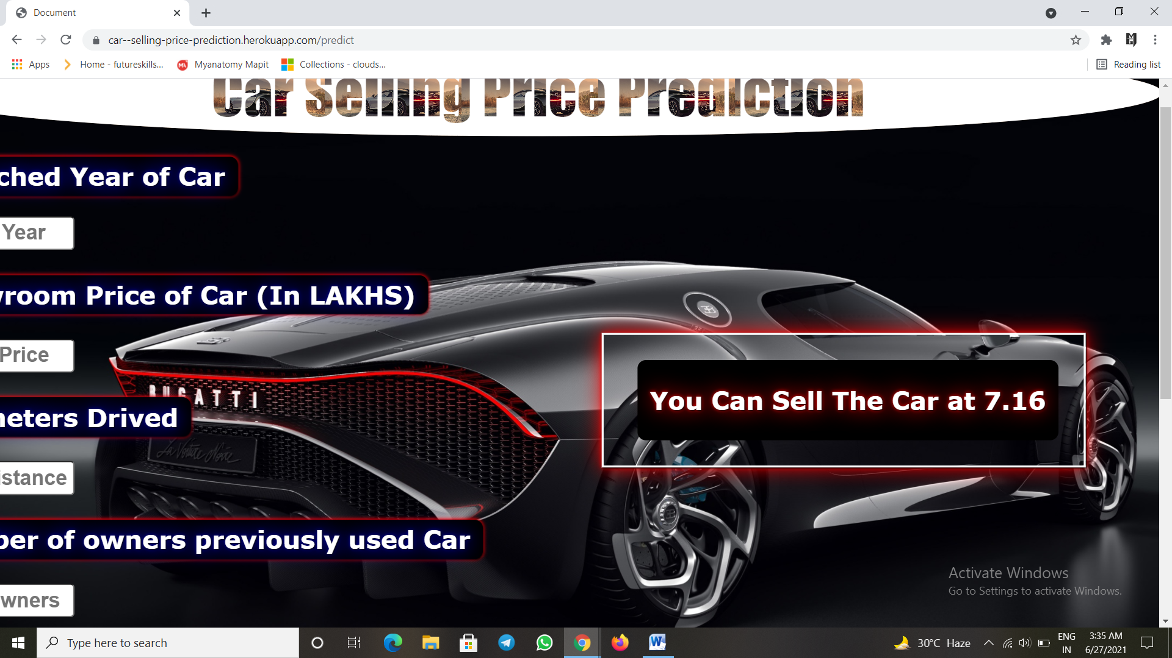
Prediction of the car selling price after a complete testing and training

Slide 19
Link for the source code repository: https://github.com/manishgautam30/Car-Selling-Price-Prediction
Link for the deployed Model:
https://car--selling-price-prediction.herokuapp.com/

Slide 20
Thank You!

